Slide 1
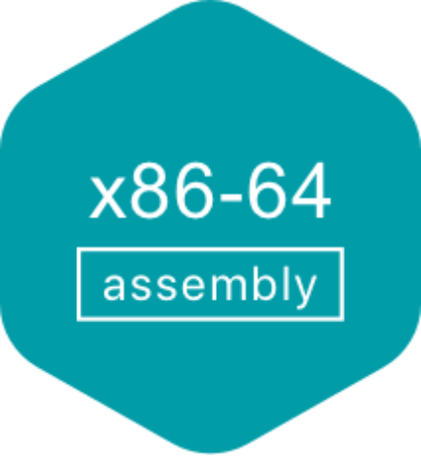
Unit 4.2 - Assembly Language
Prepared by: Koh Kian Hua

Slide 2
Objectives
After completing this unit, students should be able to:
Show understanding of the relationship between assembly language and machine code.
Describe the different stages of the assembly process for a two-pass assembler.
Trace a given simple assembly language program.
Show understanding that a set of instructions are grouped

Slide 3
Assembly Language
Assembly Language and Machine Code
The only programming language that a CPU can use is machine code.
Every different type of computer/chip has its own set of machine code instructions.
Each machine code instruction performs one simple task (eg:storing a value in a memory location at a specified address).
Machine code is binary.
Sometimes displayed on a screen as hexadecimal so that humans can understand machine code instructions more easily.
Writing programs in machine code (low-level hardware language) is a specialised task, time consuming and error prone.

Slide 4
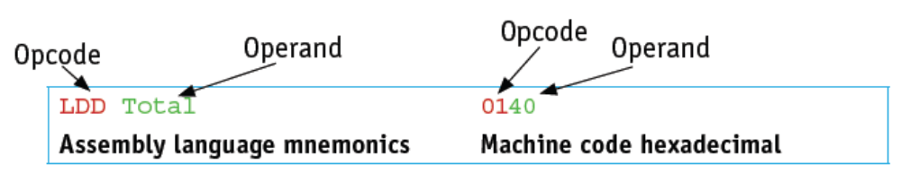
Assembly Language
Structure of Assembly Language
Each assembly language statement is split into an opcode and an operand.
The opcode is the instruction that is executed by the CPU.
The operand is the data or memory location used to execute that instruction.
Example:
Load the contents of the specified address (for Total) into ACC(Accumulator)
Note: An accumulator is a type of register for short-term, intermediate storage of arithmetic and logic data in a computer's central processing unit (CPU)

Slide 5
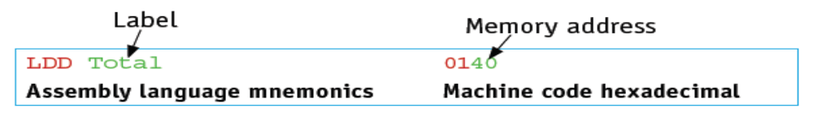
Assembly Language
Stages of Assembly
Before a program written in assembly language can be executed, it needs to be translated into machine code by a program known as an assembler.
There are two types of assembler:
Single pass assemblers - puts the machine code instructions straight into the computer memory to be executed.
Two pass assemblers - produces an object program in machine code that can be stored, loaded then executed at a later stage.
Two pass assemblers scan the source program twice and they replace labels in the assembly program with memory addresses in the machine code program.

Slide 6
Assembly Language
Operations of a Two-Pass Assembler
Pass 1
Read the assembly language program one line at a time.
Ignore anything not required, such as comments.
Allocate a memory address for the line of code.
Check the opcode is in the instruction set.
Add any new labels to the symbol table with the address, if known.
Place address of labelled instruction in the symbol table.
Pass 2
Read the assembly language program one line at a time.
Generate object code, including opcode and operand, from the symbol table generated in Pass 1.
Save or execute the program.

Slide 7
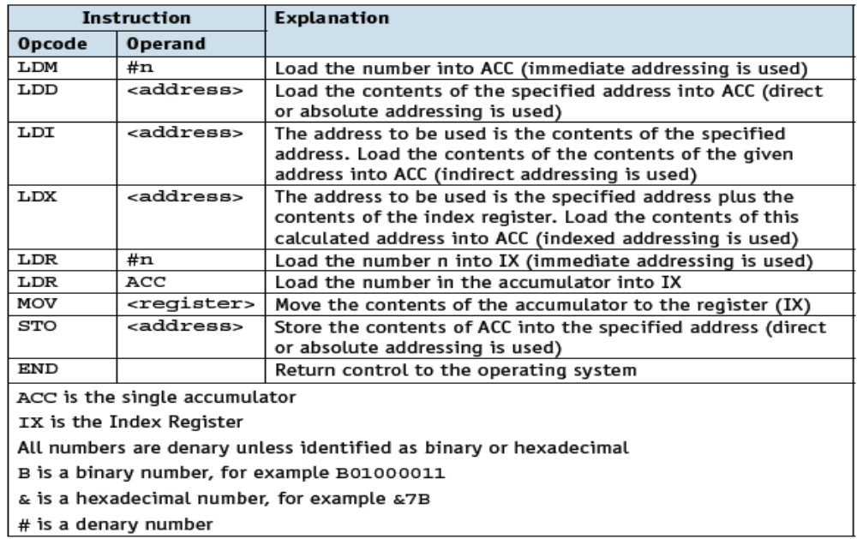
Assembly Language
Data Movement Instructions

Slide 8
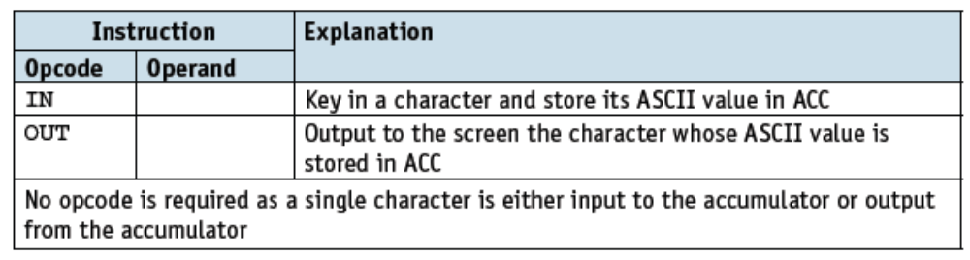
Assembly Language
Data Input & Output Instructions
These instructions allow data to be read from the keyboard or output to the screen.

Slide 9
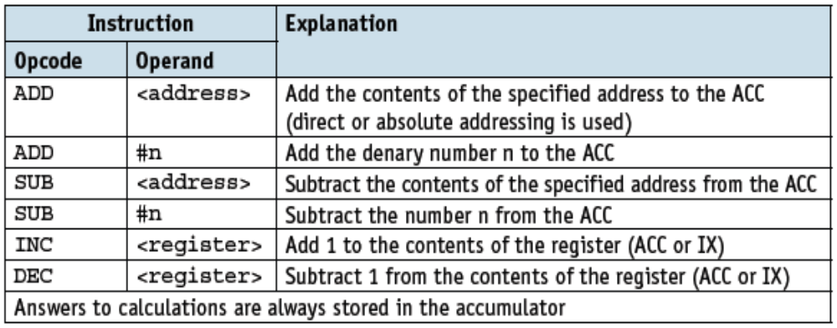
Assembly Language
Arithmetic Operations Instructions
These instructions perform simple calculations on data stored in the accumulator and store the answer in the accumulator, overwriting the original data..

Slide 10
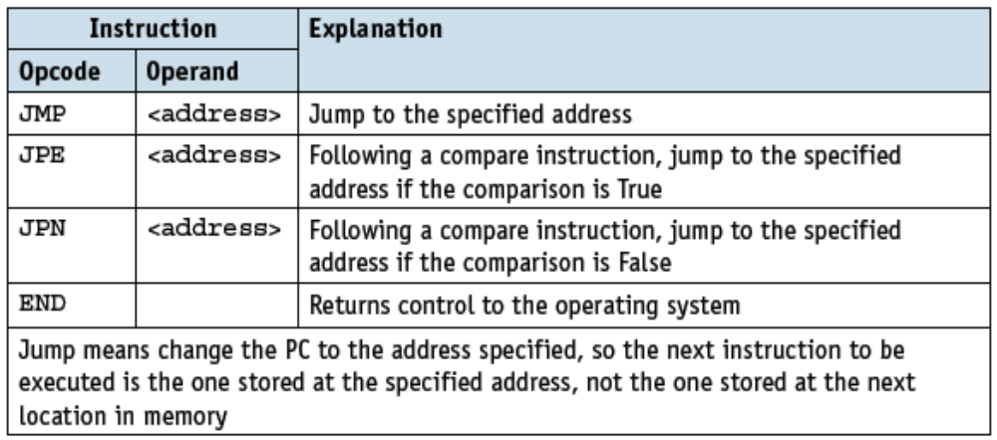
Assembly Language
Conditional and Unconditional Jump Instructions
Jump Instructions are used for changing the flow of execution of instructions in the processor. If we want jump to any instruction in between the code, then this can be achieved by these instructions.

Slide 11
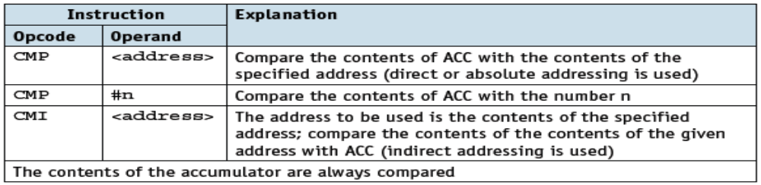
Assembly Language
Addressing Modes
CMP compares two numeric data fields. The destination operand could be either in register or in memory. The source operand could be a constant (immediate) data, register or memory.
Example:
CMP DX, 00 ; Compare the DX value with zero
JE L7 ; If yes, then jump to label L7
.
.
L7: ...

Slide 12
Assembly Language
Addressing Modes
Assembly language and machine code programs use different addressing modes depending on the requirements of the program.
These addressing modes are:
  Absolute Addressing
  Direct Addressing
  Indirect Addressing
  Indexed Addressing
  Immediate Addressing
  Relative Addressing
  Symbolic Addressing

Slide 13
Assembly Language
Addressing Modes
Absolute addressing – the contents of the memory location in the operand are used.
  Eg: if the memory location with address 200 contained the value 20, the assembly language instruction LDD 200 would store 20 in the accumulator.
Direct addressing – the contents of the memory location in the operand are used.
  Eg: if memory location with address 200 contained the value 20, the assembly language instruction LDD 200 would store 20 in the accumulator. Absolute and direct addressing are the same.
Indirect addressing – the contents of the contents of the memory location in the operand are used.
  Eg, if memory location with address 200 contained the value 20 and the memory location with address 20 contained the value 5, the assembly language instruction LDI 200 would store 5 in the accumulator.
Indexed addressing – the contents of the memory location found by adding the contents of the index register (IR) to the address of the memory location in the operand are used.
  Eg:, if IR contained the value 4 and memory location with address 204 contained the value 17, the assembly language instruction LDX 200 would store 17 in the accumulator.

Slide 14
Assembly Language
Addressing Modes
Immediate addressing – the value of the operand only is used.
  Eg: the assembly language instruction LDM #200 would store 200 in the accumulator.
Relative addressing – the memory address used is the current memory address added to the operand.
  Eg: JMR #5 would transfer control to the instruction 5 locations after the current instruction.
Symbolic addressing – only used in assembly language programming. A label is used instead of a value.
  Eg: if the memory location with address labelled MyStore contained the value 20, the assembly language instruction LDD MyStore would store 20 in the accumulator.

Slide 15
Assembly Language
Assembly Language Programs
An assembly language is a type of low-level programming language that is intended to communicate directly with a computer's hardware.
Assembly language are designed to be readable by humans.
A program written in assembly language (eg: 8086 assembly language) will need many more instructions than a program written in a high-level language (eg: Jave) to perform the same task.

Slide 16
Assembly Language
Assembly Language Programs
An assembly language is a type of low-level programming language that is intended to communicate directly with a computer's hardware.
Assembly language are designed to be readable by humans.
A program written in assembly language (eg: 8086 assembly language) will need many more instructions than a program written in a high-level language (eg: Jave) to perform the same task.

Slide 17
Assembly Language
Assembly Language vs High Level Language
In a high level language such as Python, adding three numbers together and storing the answer can be written as a single instruction:
However, the same task written using an assembly language (eg: 8086) can be as follows:
total = first + second + third
Label Opcode Operand
start: LDD first
ADD second
ADD third
STO total
END
first: #20
second: #30
third: #40
total: #0

Slide 18
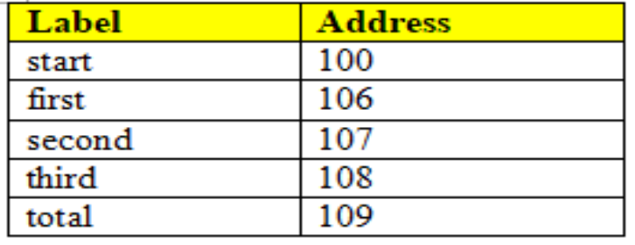
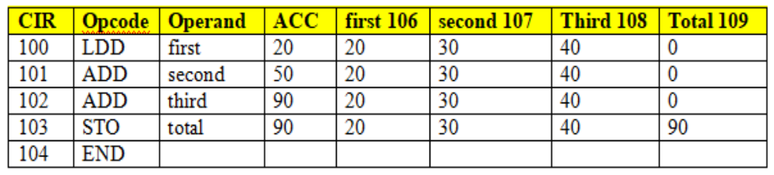
Assembly Language
Assembly Language vs High Level Language
Assuming the previous assembly program is to be loaded at memory address 100, the symbol table for this small section of program would look like this:
When the assembly code is executed, the contents of ACC, CIR and the variables used can be traced using a trace table.

Slide 19
Assembly Language
Assembly Language vs High Level Language
In a high-level language (eg: Java / Python), adding a list of numbers together and storing the answer would typically be written using a loop.
number[1] = 5
number[2] = 7
number[3] = 3
FOR counter = 1 TO 3
total = total + number[counter]
NEXT counter

Slide 20
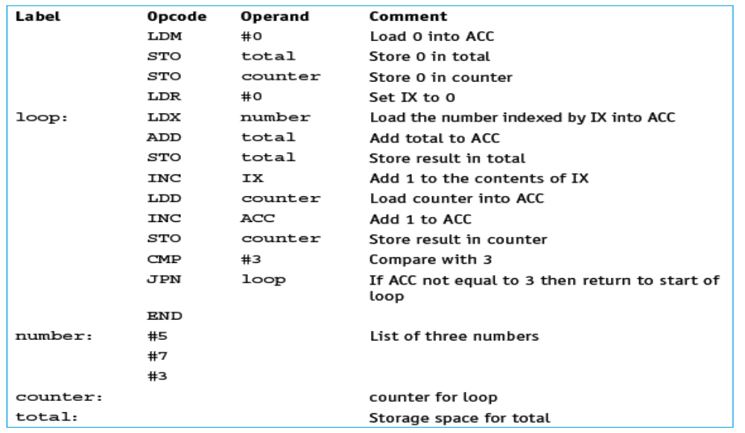
Assembly Language
Assembly Language vs High Level Language
The same task written in assembly language would require the use of the index register (IX). The assembly language program could look like this:

Slide 21
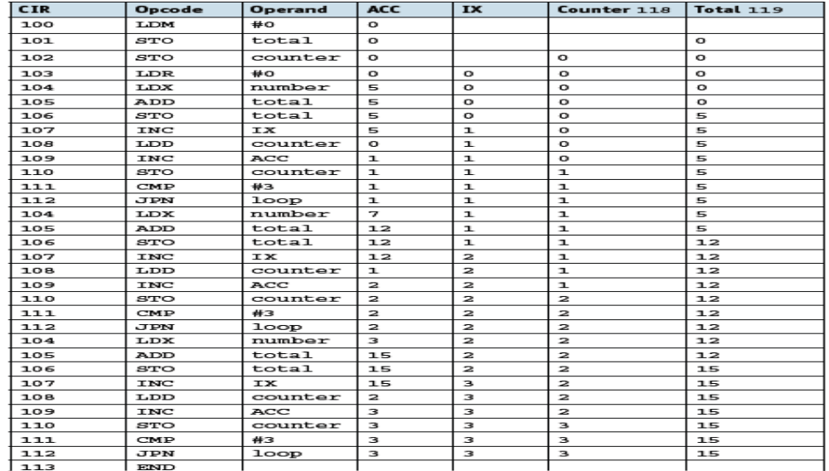
Assembly Language
Assembly Language vs High Level Language
When this section of code is executed the contents of ACC, CIR, IX and the variables used can be traced using a trace table:

Slide 22

Unit 4.3 - Bit Manipulation
Prepared by: Koh Kian Hua

Slide 23
Objectives
After completing this unit, students should be able to:
Show understanding of and perform binary shifts logical, arithmetic and cyclic, Left shift, right shift.
Show understanding of how bit manipulation can be used to monitor / control a device

Slide 24
Bit Manipulation
Binary Shifts
A shift involves moving the bits stored in a register a given number of places within the register.
Each bit within the register may be used for a different purpose (eg: Each bit of Interrupt Refister represents a different interrupt).
There are several types of shifts:
  logical shift
  arithmetic shift
  cyclic shift
  left shift
  right shift

Slide 25
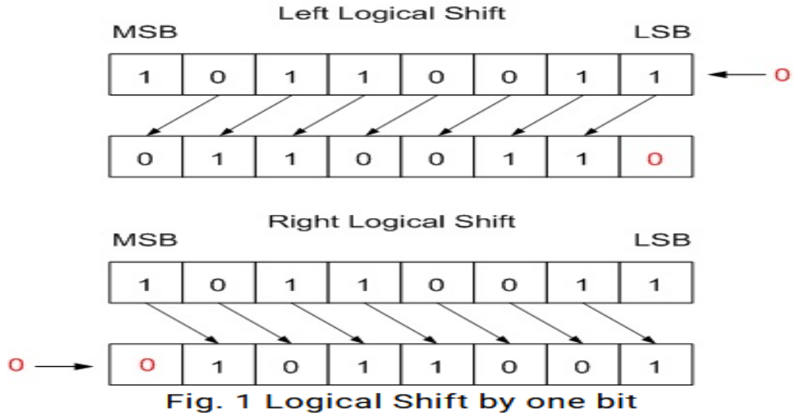
Bit Manipulation
Logical Shifts
A Left Logical Shift of one position moves each bit to the left by one. The vacant least significant bit (LSB) is filled with zero and the most significant bit (MSB) is discarded.
A Right Logical Shift of one position moves each bit to the right by one. The least significant bit is discarded and the vacant MSB is filled with zero.

Slide 26
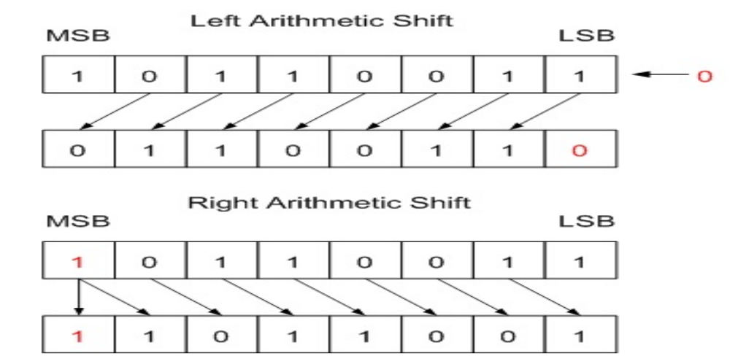
Bit Manipulation
Arithmetic Shifts
A Left Arithmetic Shift of one position moves each bit to the left by one. The vacant least significant bit (LSB) is filled with zero and the most significant bit (MSB) is discarded. It is identical to Left Logical Shift.
A Right Arithmetic Shift of one position moves each bit to the right by one. The least significant bit is discarded and the vacant MSB is filled with the value of the previous (now shifted one position to the right) MSB..

Slide 27
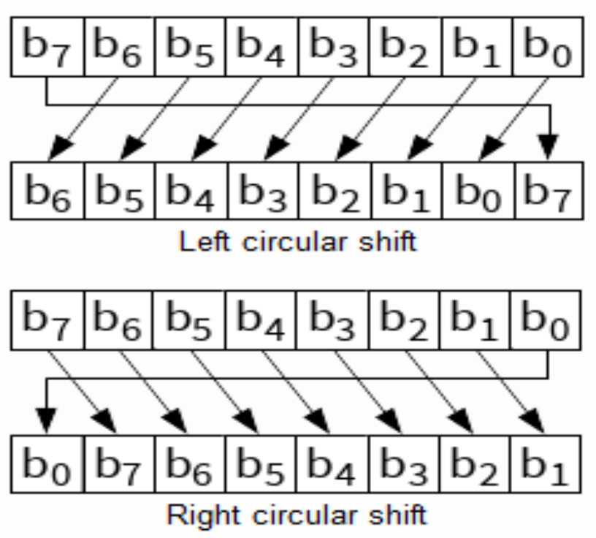
Bit Manipulation
Cyclic (Circular) Shifts
No bits are lost during a shift. Bits shifted out of one end of the register are introduced at the other end of the register. For example, an 8-bit register containing the binary value 10101111 shifted left cyclically three places would become 01111101.

Slide 28
Bit Manipulation
Left / Right Shifts
Left shift – bits are shifted to the left; gives the direction of shift for logical, arithmetic and cyclic shifts.
Right shift – bits are shifted to the right; gives the direction of shift for logical, arithmetic and cyclic shifts.
Bit Manipulation in Monitoring and Control
Bit Manipulation has a number of applications in real life. They are used to monitor systems and make changes accordingly and they are used in the vending machines.
An example:
A vending machine has different items which it can dispense.
Tea
Coffee
Chocolate
Milk
Sugar
Each button on the vending machine will give one item.

Slide 29
Assembly Language / Bit Manipulation
Class Activity
State the contents of the accumulator after the following instructions have been executed. The memory location with address 200 contains 300, the memory location with address 300 contains 50.
i) LDM #200
ii) LDD 200
iii) LDI 200
2. A programmer is writing a program in assembly language. They need to use shift instructions. Describe, using examples, three types of shift instructions the programmer could use.

